Slide 1
Radio Code Hunting Activity
Skill development: Map reading, Route Planning, Orienteering & Radio skills activity Equipment required: 2 walkie talkies per Six, Patrol, team

Slide 2
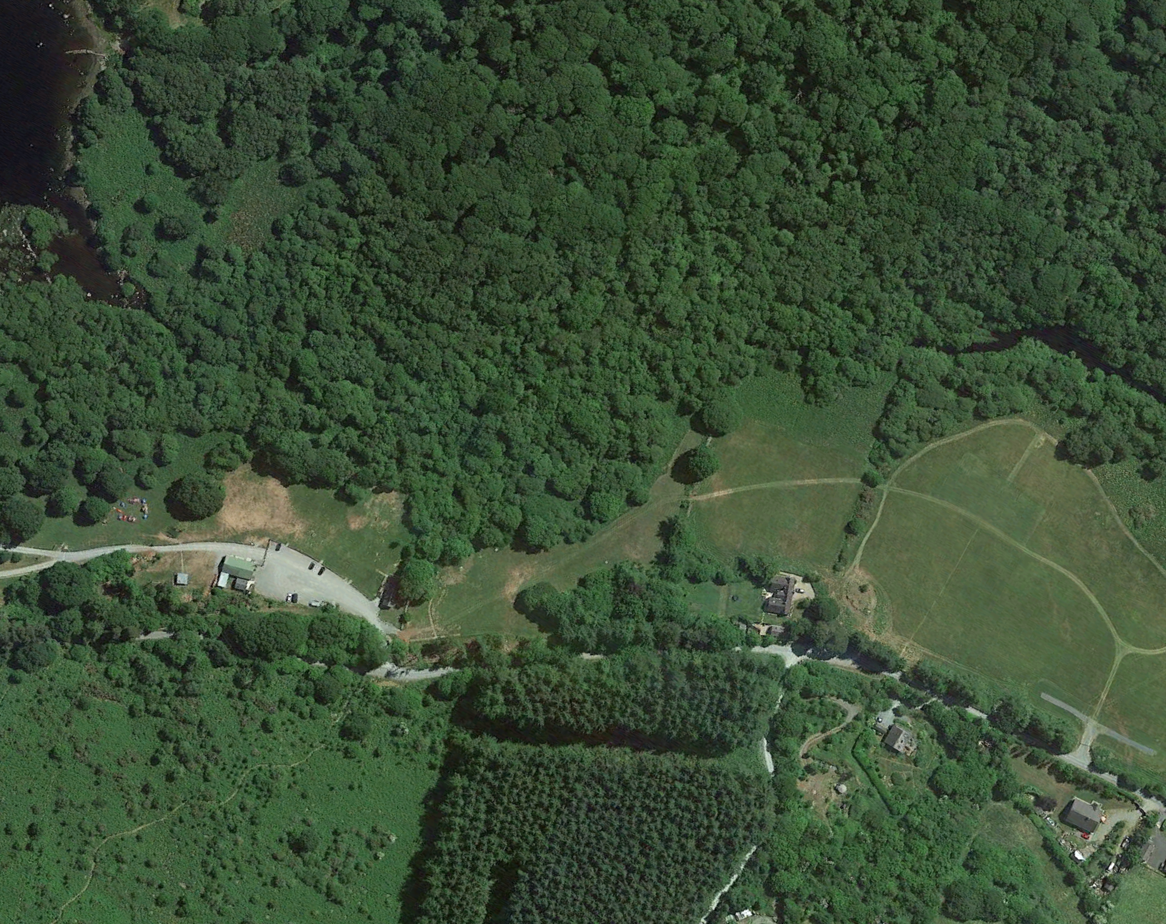
Command post
Latitude
 | 15
 | 14
 | 13
 | 12
 | 11
 | 10
 | 09
 | 08
 | 07
 | 06
 | 05
 | 04
 | 03
 | 02
 | 01
 | 00
 |  | 00 | 01 | 02 | 03 | 04 | 05 | 06 | 07 | 08 | 09 | 10 | 11 | 12 | 13 | 14 | 15
 |  | Longitude
Overview - 30-180 mins Activity
Using the Walkie Talkie the Scout PLs or Cub Sixer or a leader must guide their Sixes/Patrols to find the hidden code cards around the site. They are the Command leader
The APL/Seconder or search team lead receives the grid location directions and clue from the PL or leader and leads the search team to look for the hidden codes.
Only the Command Leader map has the code locations. The Search Leader map only has high level grid squares with no details
Command Leader will stay at command HQ and will direct their Search Leader with the search team (via walkie talkie to lat/long of each code to be retrieved as efficiently as possible – route plan.
The use of phonetic code and good radio practice to direct their search team to main grid square gains extra points. e.g. Go to grid Latitude 11 longitude 02 would be called out ”Search team, Go to Grid Latitude 11 longitude 02 and await further instructions, QSL? over”. The search team reply should be “ QSL, Search team to Grid Latitude 11 longitude 02 and await further instructions, over” –good communication and radio practice.
When the search team arrives at the grid square they call the Command leader “”Search team, at Grid Latitude 11 longitude 02 awaiting further instructions, QSL? Over”. The Command leader then has to guide the search team to where the codes are hidden on their map using the clues on their sheet as necessary. –good communication and radio practice.
Each member of the search team(agents) must pass at least one code and spell their name using phonetic code (Alpha, Bravo, Charlie etc) to the search Commander at the other end of the radio. –good communication and radio practice. Red team red codes, blue team blue codes etc.
Both the Search commander and search leader make note of each agent name & code communicated on their check sheet. – Attention to detail
Once all codes are radioed back to Command HQ the Search team returns to command HQ to have their team score checked. 5 points are scored for each code and agent name that match on the Search Leader and Command Leader. 5 points are scored for the 1st team back with all codes correct, 4 for 2nd, 8 for 3rd etc
Radio communications will be monitored and an extra 10 points will be awarded for the use of phonetic code and good communication/radio use. With 5 points for the next best team. However, beware! Up to 10 points will be deducted for any messing or bad language! You have been warned.
The may winners get a prize – evening off camp wash up, badge , treat etc as appropriate…talk to your leaders.
N
N
7
9
4
6
2
10
1
5
8
3

Slide 3
Activity Notes Customisation
The enclosed is a walkie talkie code hunt is designed for a circa 45 minute Base activity in Lough Dan that can easily be customised to any camp or park location. Course can be made shorter or longer by placing code farther away, placing more codes, making code more difficult to find with more quirky clues etc.
It is a good idea to go through and demo how to use the walkie talkies and the the good Radio Operations note before starting the game
To customize, drag the grid square overlay to the side on slides 4 and 5
Delete the google earth screen shot of lough dan on slides 4 and 5 and replace it with a google earth image or map of your camp/park etc (move the screen shot to the back and then drag the grid square overlay back over your screen shot
Walk the area of your camp/park and pick out interesting places to place or hide the code cards note the lat/long locations based on the map you have created and think about funny entertaining clues related to the surroudings. The number of locations and the distance between them determine how long the activity takes
Move the red location area dots on slide 5 to the new locations and Replace the lat/long info and clues in slide 6 and print out one copy of slide 5 & 6 for each Command/PL leader
Print out a copy of slide 4 with one of sheet 7-16 as required for each search team
Print outs can be laminated so sheets can be re-used with “dry” markers to avoid waste and make waterproof. Use fine tip dry marker pens such as https://www.huntoffice.ie/show-me-fine-point-slim-barrel-drywipe-marker-black-10pack-fpsdp.html
Any errors, omissions or suggestions for improvement, please email them to radioscoutingireland@gmail.com

Slide 4
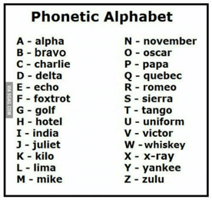
Latitude
 | 15
 | 14
 | 13
 | 12
 | 11
 | 10
 | 09
 | 08
 | 07
 | 06
 | 05
 | 04
 | 03
 | 02
 | 01
 | 00
 |  | 00 | 01 | 02 | 03 | 04 | 05 | 06 | 07 | 08 | 09 | 10 | 11 | 12 | 13 | 14 | 15
 |  | Longitude
Search Leader Map & instructions
1.) As. Search Leader your job is to take direction from your Command Leader and lead your agents to find the codes and return to base as quickly as possible.
2.) Find the code cards hidden around the site and relay the codes accurately to the radio base over the radio
2.) Your Search Command Leader will stay at Command HQ with one other team member and direct the search via walkie talkie to the location of each code to be retrieved. For example, the 1st code is at the phone reception pole”- Latitude 06, Longitude 04, with the clue “A strong signal may help you find the 1st code”
example the 1st code is at the “Deserted shacks”- Latitude 11, Longitude 02
3.) The use of phonetic code and good radio practice to direct their search team to main grid square gains extra points. e.g. Go to grid Latitude 11 longitude 02 would be called out ”Search team, Go to Grid Latitude 11 longitude 02 and await further instructions, QSL? over”. The search team reply should be “ QSL, Search team to Grid Latitude 11 longitude 02 and await further instructions, over” –good communication and radio practice.
4.) When the search team arrives at the grid square they call the Command leader “”Search team, at Grid Latitude 11 longitude 02 awaiting further instructions, QSL? Over”. The Command leader then has to guide the search team to where the codes are hidden on their map using the clues on their sheet as necessary. –good communication and radio practice.
5.) Each member of the search team(agents) must pass at least one code and spell their name using phonetic code (Alpha, Bravo, Charlie etc) to the search Commander at the other end of the radio. –good communication and radio practice.
6.) Both the Search commander and search leader make note of each agent name & code communicated on their check sheet. – Attention to detail
7.) Once all codes are radioed back to Command HQ the Search team returns to command HQ to have their team score checked. 5 points are scored for each code and agent name that match on the Search Leader and Command Leader. 5 points are scored for the 1st team back with all codes correct, 4 for 2nd, 8 for 3rd etc
8.) Radio communications will be monitored and an extra 10 points will be awarded for the use of phonetic code and good communication/radio use. With 5 points for the next best team. However beware! Up to 10 points will be deducted for any messing or bad language.
9.) The may winners get a prize – evening off camp wash up, badge , treat etc as appropriate…talk to your leaders.
N
N

Slide 5
Latitude
 | 15
 | 14
 | 13
 | 12
 | 11
 | 10
 | 09
 | 08
 | 07
 | 06
 | 05
 | 04
 | 03
 | 02
 | 01
 | 00
 |  | 00 | 01 | 02 | 03 | 04 | 05 | 06 | 07 | 08 | 09 | 10 | 11 | 12 | 13 | 14 | 15
 |  | Longitude
Command Leader Map & instructions
1.) There are 10 secret search codes hidden around Lough Dan that must be retrieved correctly by your team
2.) As Command Leader your job is to give good directions to the search Leader and search team to find the codes and return to base as quickly as possible. Perhaps consider what might be the most efficient route or order to do each grid sq?
2.) Your Search Leader and team will listen to your directions and try and find the codes. For example, the 1st code is at the phone reception pole- Latitude 06, Longitude 04, with the clue “A strong signal may help you find the 1st code”. You will give similar instructions to your team to retrieve all the codes.
3.) The use of phonetic code and good radio practice to direct the search team to main grid square gains extra points. e.g. Go to grid Latitude 11 longitude 02 would be called out ”Search team, Go to Grid Latitude 11 longitude 02 and await further instructions, QSL? over”. The search team reply should be “ QSL, Search team to Grid Latitude 11 longitude 02 and await further instructions, over” –good communication and radio practice.
4.) When the search team arrives at the grid square they call the Command leader “”Search team, at Grid Latitude 11 longitude 02 awaiting further instructions, QSL? Over”. The Command leader then has to guide the search team to where the codes are hidden on their map using the clues on their sheet as necessary. –good communication and radio practice.
5.) Each member of the search team(agents) must pass at least one code and spell their name using the phonetic alphabet (Alpha, Bravo, Charlie etc) to the search Commander at the other end of the radio. –good communication and radio practice.
6.) Both the Search commander and search leader make note of each agent name & code communicated on their check sheet. – Attention to detail
7.) Once all codes are radioed back to Command HQ, or time has run out, the Search team returns to command HQ to have their team score checked. 5 points are scored for each code and agent name that match on the Search Leader and Command Leader. 5 points are scored for the 1st team back with all codes correct, 4 for 2nd, 8 for 3rd etc
8.) Radio communications will be monitored, and an extra 10 points will be awarded for the use of phonetic code and good communication/radio use. With 5 points for the next best team. However, beware! Up to 10 points will be deducted for any messing or bad language over the airwaves! You have been warned.
9.) The winners might get a prize – evening off wash up, badge etc as appropriate. Talk to your leaders!
N
N
7
9
4
6
2
10
1
5
8
3

Slide 6
Command - Scout PLs or Cub Sixer or a leader log Team/color:
Code Location | Code collected | Scout 1st name | Latitude | Longitude | Direction Clue
1 |  |  | 065 | 040 | A strong signal may help you find the 1st code
2 |  |  | 070 | 075 | Seek what you want in the spooky forest glade you’ll need no spade
3 |  |  | 048 | 092 | Escape the backwoods towards the road
4 |  |  | 072 | 103 | Don’t be left behind managing the wildlife
5 |  |  | 050 | 113 | Near the gate to hunters house your clue might be, but beware of the dogs!
6 |  |  | 077 | 127 | Orienteering behind the hedgerow
7 |  |  | 094 | 155 | Seek your next code near the waters edge
8 |  |  | 045 | 054 | When you come in on the left there's a grey box on the wall, find it and there’s no need to bawl
9 |  |  | 070 | 032 | In the long grass try to find the 2nd last clue, but hurry up mind!
10 |  |  | 060 | 002 | Some bird tweet, other birds twitter, your on the last code, hurry don’t flitter!
11
12
13
14
15
Good radio operations
1.) Listen and wait for other operator to finish
2.) Wait half a second after pressing the transmit button before speaking
3.) Say “over” at the end of your communication so the other operator knows you have finished speaking
4.) Say “ Say again please, over” if you need the other operator to repeat what they said.
5.) When you repeat your message confirm you have been heard by adding QSL? E.g. My message was “go to Deserted shacks - Latitude 11, Longitude 02, QSL?” QSL means did you hear me?
6.) If you have heard the repeated message you answer saying QSL twice and repeating back the message and over.g. “QSL, QSL Go to Deserted shacks Latitude 11, Longitude 02, Over”
7.) Scout leaders listen in an award points for good radio operation
Note: With multiple teams it is good to stagger stating locations e.g.
Green team start at Code 1, then 2,3 etc.
Red team start at code 3, then 4,5 etc and back to 1 and 2
Orange team start at code 5, then 6,7 and back to 1,2,3 etc

Slide 7
Green search team code log
Code Location | Code collected | Scout 1st name | Latitude | Longitude | Did you need the Clue ? Yes/No
1
2
3
4
5
6
7
8
9
10
11
12
13
14
15
Good radio operations
1.) Listen and wait for other operator to finish
2.) Wait half a second after pressing the transmit button before speaking
3.) Say “over” at the end of your communication so the other operator knows you have finished speaking
4.) Say “ Say again please, over” if you need the other operator to repeat what they said.
5.) When you repeat your message confirm you have been heard by adding QSL? E.g. My message was “go to Deserted shacks - Latitude 11, Longitude 02, QSL?” QSL means did you hear me?
6.) If you have heard the repeated message you answer saying QSL twice and repeating back the message and over.g. “QSL, QSL Go to Deserted shacks Latitude 11, Longitude 02, Over”

Slide 8
Red team search code log
Code Location | Code collected | Scout 1st name | Latitude | Longitude | Did you need the Clue ? Yes/No
1
2
3
4
5
6
7
8
9
10
11
12
13
14
15
Good radio operations
1.) Listen and wait for other operator to finish
2.) Wait half a second after pressing the transmit button before speaking
3.) Say “over” at the end of your communication so the other operator knows you have finished speaking
4.) Say “ Say again please, over” if you need the other operator to repeat what they said.
5.) When you repeat your message confirm you have been heard by adding QSL? E.g. My message was “go to Deserted shacks - Latitude 11, Longitude 02, QSL?” QSL means did you hear me?
6.) If you have heard the repeated message you answer saying QSL twice and repeating back the message and over.g. “QSL, QSL Go to Deserted shacks Latitude 11, Longitude 02, Over”

Slide 9
Blue team search code log
Code Location | Code collected | Scout 1st name | Latitude | Longitude | Did you need the Clue ? Yes/No
1
2
3
4
5
6
7
8
9
10
11
12
13
14
15
Good radio operations
1.) Listen and wait for other operator to finish
2.) Wait half a second after pressing the transmit button before speaking
3.) Say “over” at the end of your communication so the other operator knows you have finished speaking
4.) Say “ Say again please, over” if you need the other operator to repeat what they said.
5.) When you repeat your message confirm you have been heard by adding QSL? E.g. My message was “go to Deserted shacks - Latitude 11, Longitude 02, QSL?” QSL means did you hear me?
6.) If you have heard the repeated message you answer saying QSL twice and repeating back the message and over.g. “QSL, QSL Go to Deserted shacks Latitude 11, Longitude 02, Over”

Slide 10
Yellow team search code log
Code Location | Code collected | Scout 1st name | Latitude | Longitude | Did you need the Clue ? Yes/No
1
2
3
4
5
6
7
8
9
10
11
12
13
14
15
Good radio operations
1.) Listen and wait for other operator to finish
2.) Wait half a second after pressing the transmit button before speaking
3.) Say “over” at the end of your communication so the other operator knows you have finished speaking
4.) Say “ Say again please, over” if you need the other operator to repeat what they said.
5.) When you repeat your message confirm you have been heard by adding QSL? E.g. My message was “go to Deserted shacks - Latitude 11, Longitude 02, QSL?” QSL means did you hear me?
6.) If you have heard the repeated message you answer saying QSL twice and repeating back the message and over.g. “QSL, QSL Go to Deserted shacks Latitude 11, Longitude 02, Over”

Slide 11
Orange/Cream team search code log
Code Location | Code collected | Scout 1st name | Latitude | Longitude | Did you need the Clue ? Yes/No
1
2
3
4
5
6
7
8
9
10
11
12
13
14
15
Good radio operations
1.) Listen and wait for other operator to finish
2.) Wait half a second after pressing the transmit button before speaking
3.) Say “over” at the end of your communication so the other operator knows you have finished speaking
4.) Say “ Say again please, over” if you need the other operator to repeat what they said.
5.) When you repeat your message confirm you have been heard by adding QSL? E.g. My message was “go to Deserted shacks - Latitude 11, Longitude 02, QSL?” QSL means did you hear me?
6.) If you have heard the repeated message you answer saying QSL twice and repeating back the message and over.g. “QSL, QSL Go to Deserted shacks Latitude 11, Longitude 02, Over”

Slide 12
Purple team search code log
Code Location | Code collected | Scout 1st name | Latitude | Longitude | Did you need the Clue ? Yes/No
1
2
3
4
5
6
7
8
9
10
11
12
13
14
15
Good radio operations
1.) Listen and wait for other operator to finish
2.) Wait half a second after pressing the transmit button before speaking
3.) Say “over” at the end of your communication so the other operator knows you have finished speaking
4.) Say “ Say again please, over” if you need the other operator to repeat what they said.
5.) When you repeat your message confirm you have been heard by adding QSL? E.g. My message was “go to Deserted shacks - Latitude 11, Longitude 02, QSL?” QSL means did you hear me?
6.) If you have heard the repeated message you answer saying QSL twice and repeating back the message and over.g. “QSL, QSL Go to Deserted shacks Latitude 11, Longitude 02, Over”

Slide 13
Brown team search code log
Code Location | Code collected | Scout 1st name | Latitude | Longitude | Did you need the Clue ? Yes/No
1
2
3
4
5
6
7
8
9
10
11
12
13
14
15
Good radio operations
1.) Listen and wait for other operator to finish
2.) Wait half a second after pressing the transmit button before speaking
3.) Say “over” at the end of your communication so the other operator knows you have finished speaking
4.) Say “ Say again please, over” if you need the other operator to repeat what they said.
5.) When you repeat your message confirm you have been heard by adding QSL? E.g. My message was “go to Deserted shacks - Latitude 11, Longitude 02, QSL?” QSL means did you hear me?
6.) If you have heard the repeated message you answer saying QSL twice and repeating back the message and over.g. “QSL, QSL Go to Deserted shacks Latitude 11, Longitude 02, Over”

Slide 14
White team search code log
Code Location | Code collected | Scout 1st name | Latitude | Longitude | Did you need the Clue ? Yes/No
1
2
3
4
5
6
7
8
9
10
11
12
13
14
15
Good radio operations
1.) Listen and wait for other operator to finish
2.) Wait half a second after pressing the transmit button before speaking
3.) Say “over” at the end of your communication so the other operator knows you have finished speaking
4.) Say “ Say again please, over” if you need the other operator to repeat what they said.
5.) When you repeat your message confirm you have been heard by adding QSL? E.g. My message was “go to Deserted shacks - Latitude 11, Longitude 02, QSL?” QSL means did you hear me?
6.) If you have heard the repeated message you answer saying QSL twice and repeating back the message and over.g. “QSL, QSL Go to Deserted shacks Latitude 11, Longitude 02, Over”

Slide 15
Black team search code log
Code Location | Code collected | Scout 1st name | Latitude | Longitude | Did you need the Clue ? Yes/No
1
2
3
4
5
6
7
8
9
10
11
12
13
14
15
Good radio operations
1.) Listen and wait for other operator to finish
2.) Wait half a second after pressing the transmit button before speaking
3.) Say “over” at the end of your communication so the other operator knows you have finished speaking
4.) Say “ Say again please, over” if you need the other operator to repeat what they said.
5.) When you repeat your message confirm you have been heard by adding QSL? E.g. My message was “go to Deserted shacks - Latitude 11, Longitude 02, QSL?” QSL means did you hear me?
6.) If you have heard the repeated message you answer saying QSL twice and repeating back the message and over.g. “QSL, QSL Go to Deserted shacks Latitude 11, Longitude 02, Over”

Slide 16
Grey team search code log
Code Location | Code collected | Scout 1st name | Latitude | Longitude | Did you need the Clue ? Yes/No
1
2
3
4
5
6
7
8
9
10
11
12
13
14
15
Good radio operations
1.) Listen and wait for other operator to finish
2.) Wait half a second after pressing the transmit button before speaking
3.) Say “over” at the end of your communication so the other operator knows you have finished speaking
4.) Say “ Say again please, over” if you need the other operator to repeat what they said.
5.) When you repeat your message confirm you have been heard by adding QSL? E.g. My message was “go to Deserted shacks - Latitude 11, Longitude 02, QSL?” QSL means did you hear me?
6.) If you have heard the repeated message you answer saying QSL twice and repeating back the message and over.g. “QSL, QSL Go to Deserted shacks Latitude 11, Longitude 02, Over”

